Slide 1
PISA 2009 Dataset Analysis
Exploring the impact of background and technology on reading performance
Using Hadoop, Ambari, and Zeppelin

Slide 2
Slide 1: Problem Statement
Educational performance is influenced by multiple socio-economic factors.
Identifying key contributors to reading performance helps shape policy and intervention.
We aim to analyze how background, nutrition, and technology access affect student outcomes.

Slide 3
Slide 2: Why PISA 2009 Dataset?
Internationally recognized student assessment dataset.
Covers wide demographic and educational variables.
Suitable for analyzing performance across various socio-economic groups.

Slide 4
Slide 3: Dataset Summary
Rows: 3,663 students | Columns: 24 features.
Target: readingScore.
Includes features like parental education, internet access, and preschool attendance.

Slide 5
Slide 4: Technical Architecture
Data uploaded to Hadoop HDFS.
Hive used to query structured data.
Ambari used to manage services.
Zeppelin used for visualization.

Slide 6
Slide 5: Workflow Diagram
1. Upload dataset to HDFS
2. Create Hive table
3. Run queries to explore relationships
4. Visualize results in Zeppelin notebook

Slide 7
Slide 6: Technologies Used
Hadoop (HDFS) - Distributed storage
Hive - SQL-like data querying
Ambari - Service management dashboard
Zeppelin - Interactive notebooks for visualization

Slide 8
Slide 7: Data Preprocessing
Missing values handled (mean/mode).
Categorical data normalized where needed.
Filtered relevant columns related to research theme.

Slide 9
Slide 8: Hive Queries Used
SELECT lunch, AVG(readingScore) ... GROUP BY lunch;
SELECT parental_edu, AVG(readingScore) ...
SELECT internet_access, AVG(readingScore) ...

Slide 10
Slide 9: Analysis Overview
Used group-wise average reading score analysis.
Explored impact of access to computer, library, and preschool.
Generated charts using Zeppelin.

Slide 11
Slide 10: Key Findings
Students with computer access had higher reading scores.
Preschool attendance positively impacted scores.
Parental education level showed clear correlation with performance.

Slide 12
Slide 11: Visual Insights
Bar charts visualized each factor’s impact.
Clear difference seen across groups (e.g., Yes vs No for technology access).
Zeppelin enabled clean chart output for insights.

Slide 13
Slide 12: Metrics Used
Average Reading Score (primary metric).
Grouped comparisons (Yes/No, High School/No).
Visual trends used to draw data-driven conclusions.

Slide 14
Slide 13: Conclusion
Preschool, parental education, and tech access positively affect reading scores.
Hadoop ecosystem enabled scalable analysis.
Zeppelin helped visualize patterns clearly.

Slide 15
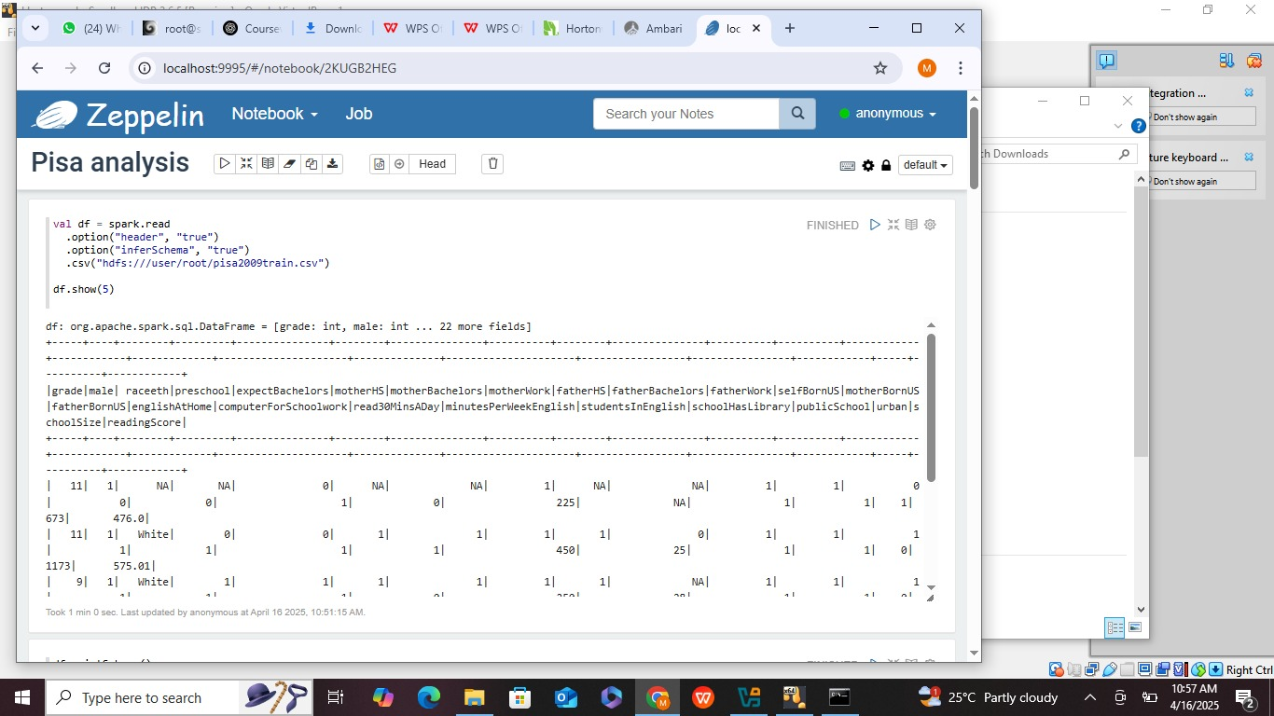
Zeppelin Pictures

Slide 17
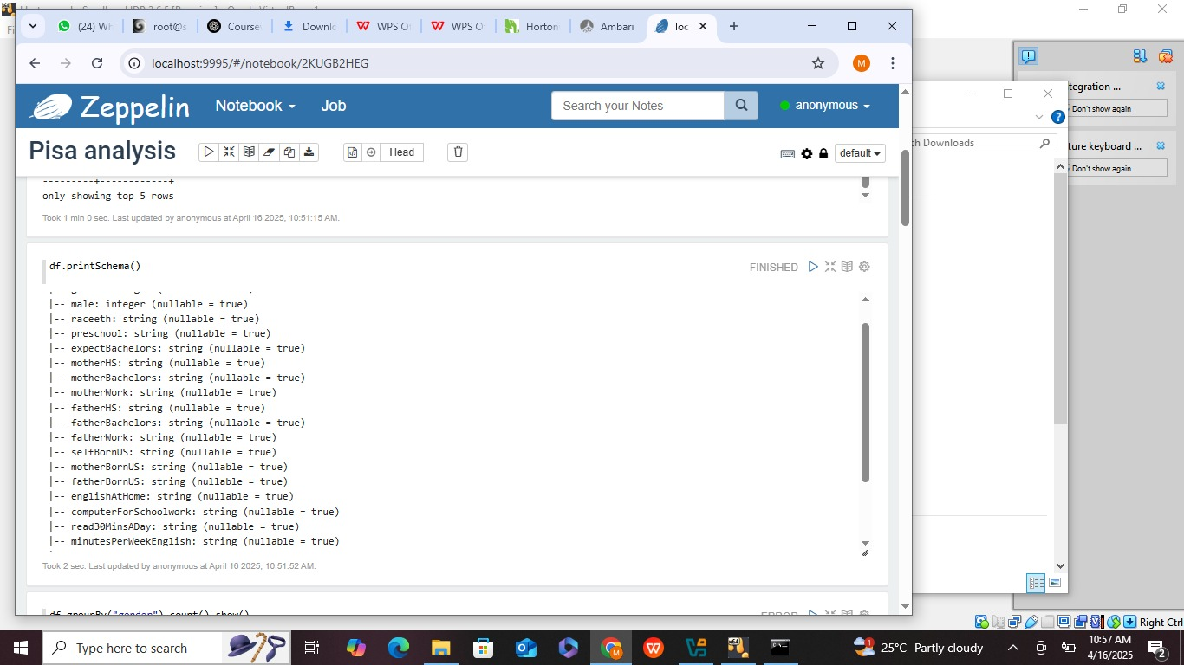

Slide 18
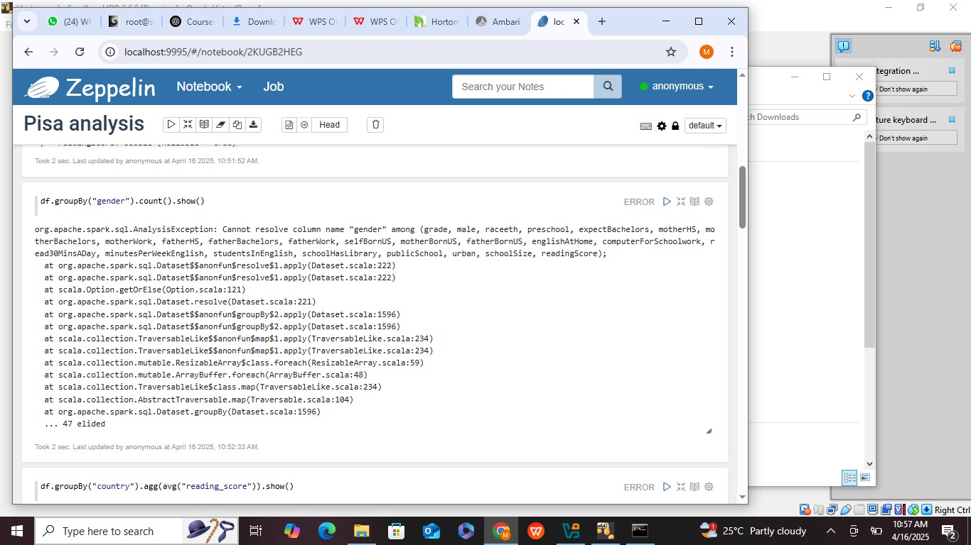

Slide 19
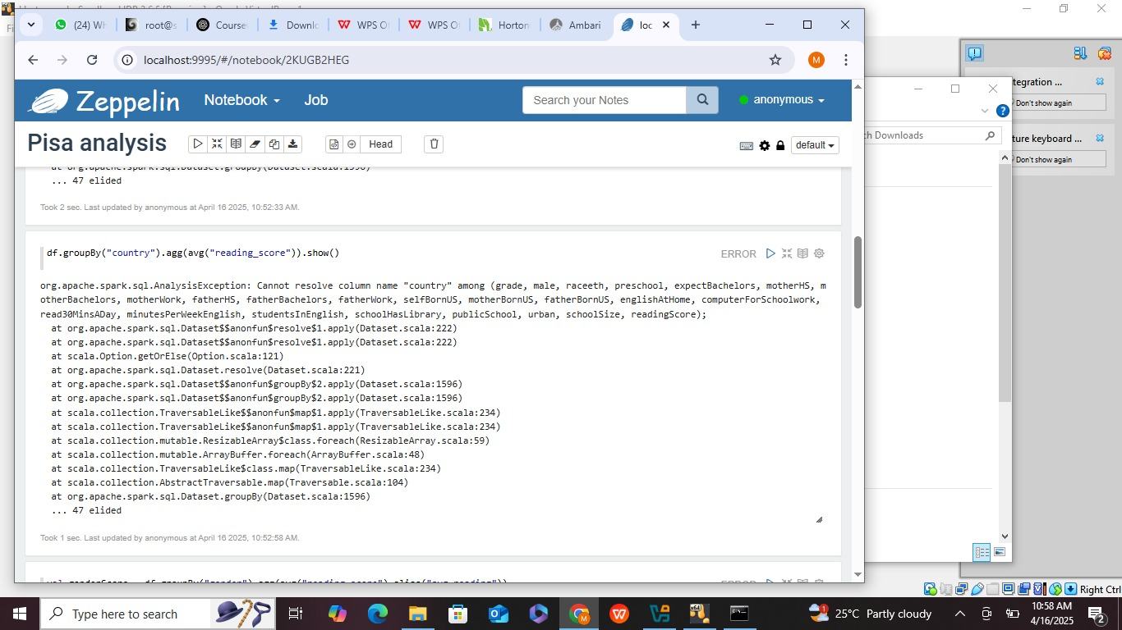

Slide 20
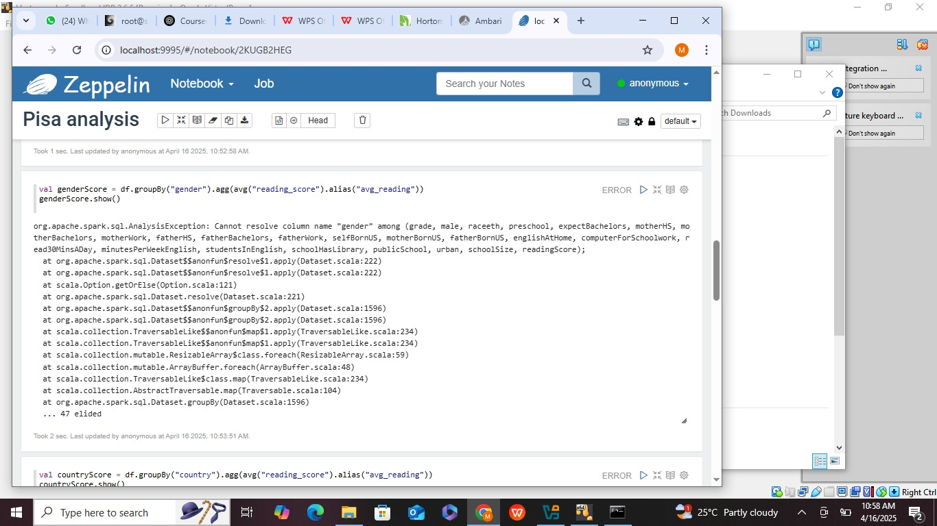

Slide 21
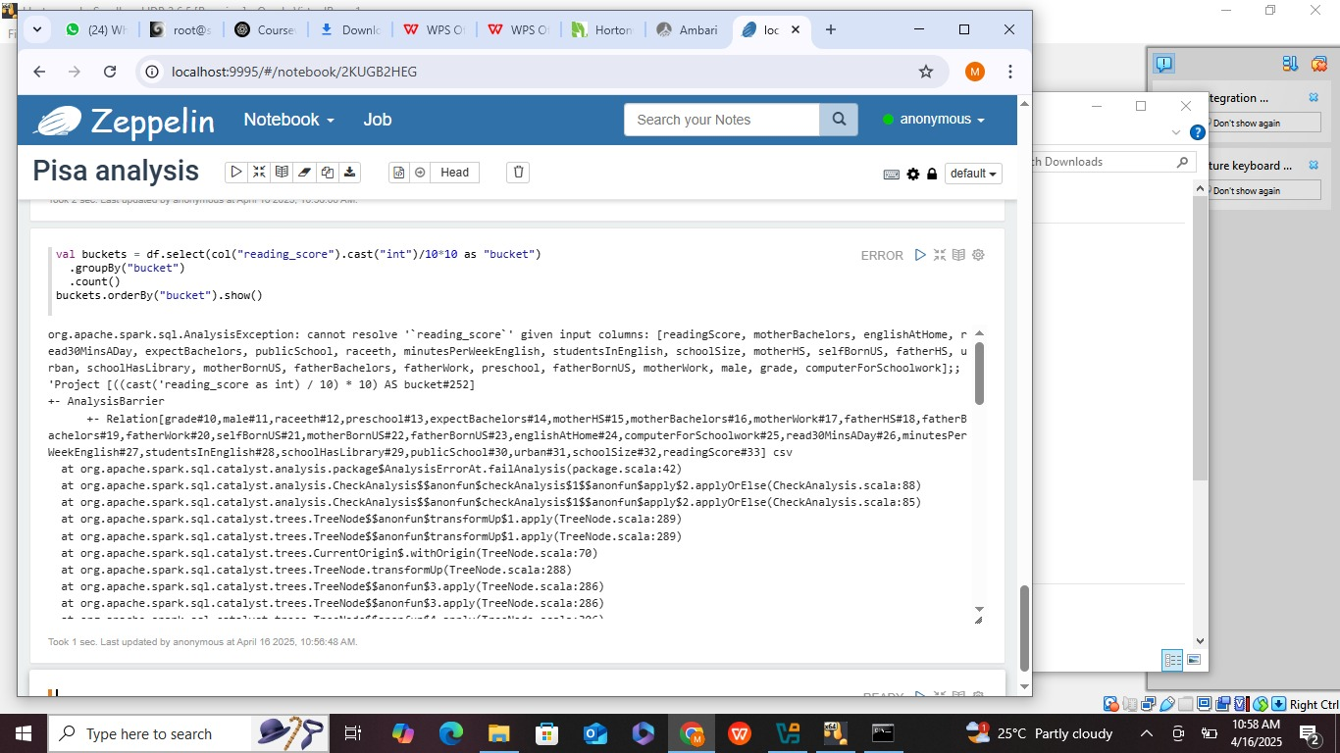

Slide 22
Slide 14: References
PISA 2009 Dataset (Kaggle)
Apache Hadoop: https://hadoop.apache.org/
Apache Hive: https://hive.apache.org/
Apache Zeppelin: https://zeppelin.apache.org/
Ambari Docs: https://ambari.apache.org/

